Slide 1
PPT 템플릿 형식 출처 : https://m.blog.naver.com/PostList.naver?blogId=seiru523(Saebyeol’s PowerPoint)
고객의 신뢰도 예측
고객 정보에 따른 신용카드 연체 예측
김 용 권
21.07.02

Slide 2
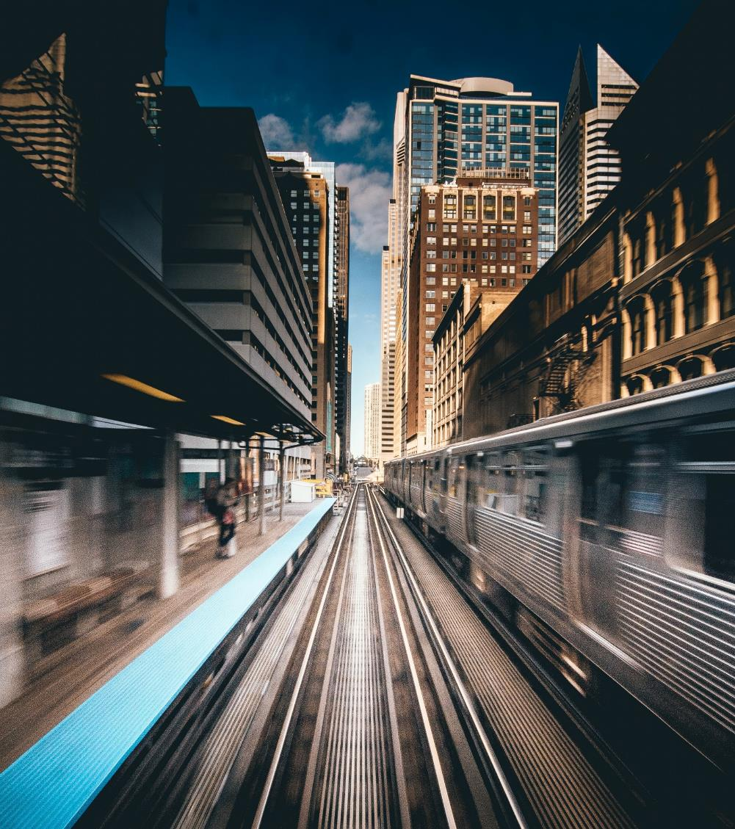

목차
A table of contents
1
분석 이유 및 목표
2
데이터 및 머신 러닝 모델
3
예측 결과 및 분석
4
총평
ⓒSaebyeol Yu. Saebyeol’s PowerPoint

Slide 3

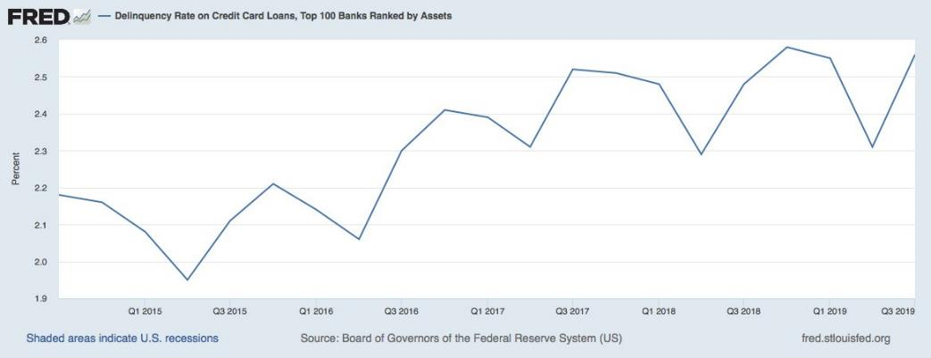
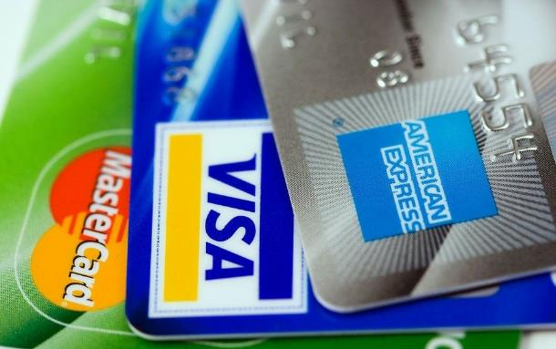


분석 이유
출처 : https://fred.stlouisfed.org/
BANK
Risk
Default

Slide 4
분석 목표
Personnel
Privately Owning
Income/job
Status & Target
Gender
Is there a property
Occupation
0: 1-29 days past due
1: 30-59 days past due
2: 60-89 days overdue
3: 90-119 days overdue
4: 120-149 days overdue
5: Overdue or bad debts,
write-offs for more than 150 days
Birthday
Is there a mobile phone
Income category
OVERDUE : 1
(BAD)
Family size
Number of Children
Is there an email
Annual income
Marital status
Is there a phone
Start date of employment
NOT-OVERDUE : 0
(GOOD)
C: paid off that month
X: No loan for the month
Way of living
Is there a work phone
Education Level
Is there a car
Number of children

Slide 5
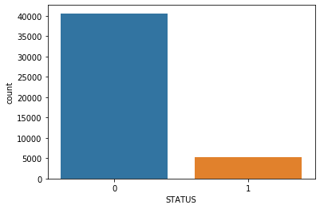
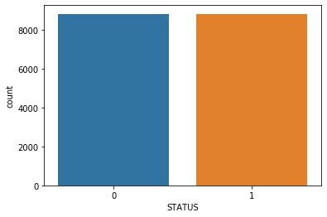
데이터
NOT-OVERDUE : 0
(GOOD)
OVERDUE : 1
(BAD)
Balancing
BaseLine Accuracy: 0.88
BaseLine Accuracy: 0.5
Target Data : Imbalance

Slide 6
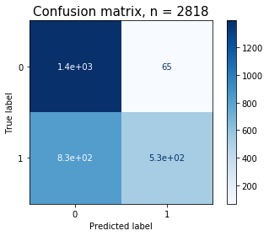
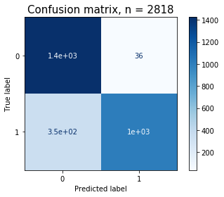
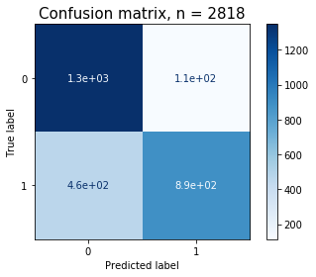
모델 학습 및 결과
Pecision : 값이 높다는것은 알고리즘이 관련있는 결과를 그렇지 못한것 대비 충분히 맞춤
Recall : 알고리즘이 관련있는 결과를 최대한 많이 가져왔다는 의미
F1-Score: 1에 가까울 수록 최적의 Precision과 Recall을 의미
Accuracy : 전체 표본 중 정확히 분류된 표본의 수
Decision Tree
XGBoost
Random Forest
Decision Tree
 | Precision | Recall | F1-Score | Accuracy
0 | 0.63 | 0.96 | 0.76
1 | 0.89 | 0.39 | 0.54
 |  |  |  | 0.68
XGBoost
 | Precision | Recall | F1-Score | Accuracy
0 | 0.8 | 0.98 | 0.88
1 | 0.97 | 0.74 | 0.84
 |  |  |  | 0.86
Random Forest
 | Precision | Recall | F1-Score | Accuracy
0 | 0.74 | 0.92 | 0.82
1 | 0.89 | 0.66 | 0.76
 |  |  |  | 0.79
BEST

Slide 7
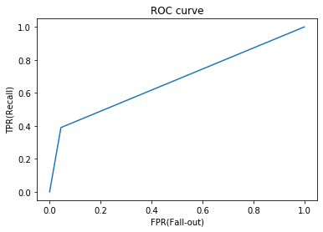
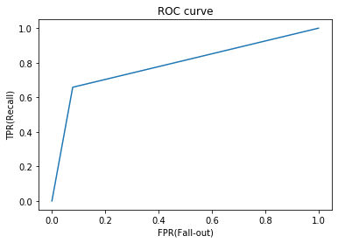
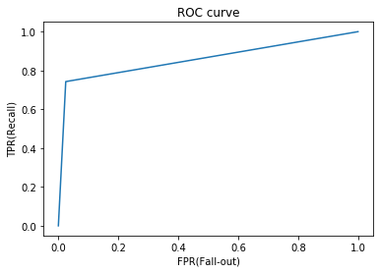
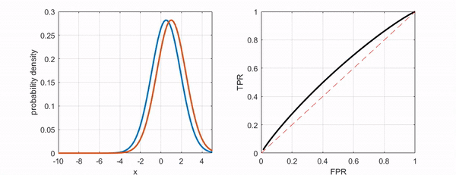
모델의 성능 비교
Decision Tree
Random Forest
XGBoost
이미지 출처 :https://angeloyeo.github.io/2020/08/05/ROC.html

Slide 8
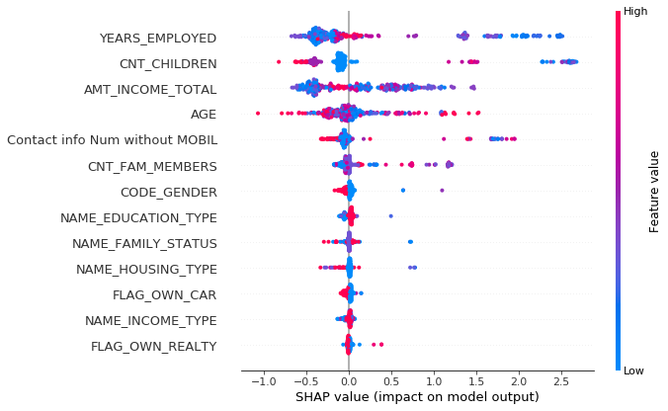
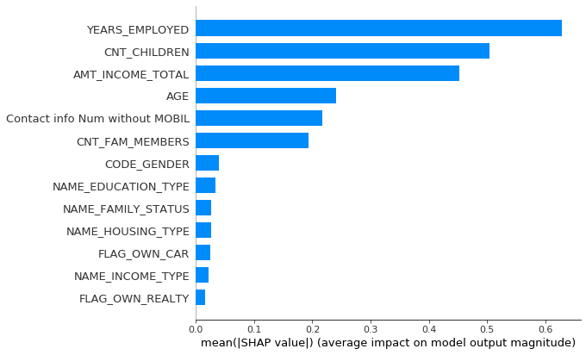
Feature Importance
Feature Importance

Slide 9
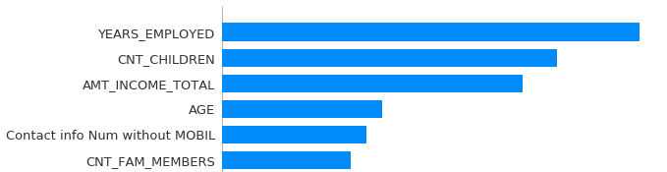
모델 분석
Feature와 내용
Feature name | Explanation
ID | Client number
CODE_GENDER | Gender
FLAG_OWN_CAR | Is there a car
FLAG_OWN_REALTY | Is there a property
CNT_CHILDREN | Number of children (personnel)
AMT_INCOME_TOTAL | Annual income (Income/job)
NAME_INCOME_TYPE | Income category
NAME_EDUCATION_TYPE | Education level
NAME_FAMILY_STATUS | Marital status
NAME_HOUSING_TYPE | Way of living
DAYS_BIRTH (→ AGE) | Birthday (personnel)
DAYS_EMPLOYED (→ YEARS_EMPLOYED) | Start date of employment (Income/job)
FLAG_MOBIL | Is there a mobile phone
FLAG_WORK_PHONE | Is there a work phone | Contact info Num without MOBIL
FLAG_PHONE | Is there a phone
FLAG_EMAIL | Is there an email
OCCUPATION_TYPE | Occupation
CNT_FAM_MEMBERS | Family size (personnel)
일을 하는지 안 하는지
수입은 얼마나 되는지
연락 가능 수단은 어느 정도인지
나이는 몇살인지
가족은 몇 명인지
아이는 몇명인지

Slide 10
총평
XGBoost
 | Precision | Recall | F1-Score | Accuracy
0 | 0.8 | 0.98 | 0.88
1 | 0.97 | 0.74 | 0.84
 |  |  |  | 0.86

Slide 11

감사 합니다
ⓒSaebyeol Yu. Saebyeol’s PowerPoint

